Slide 1
EUROASPIRE I - III
Professor David A Wood
Garfield Weston Professor of Cardiovascular Medicine
International Centre for Circulatory Health
Imperial College London

Slide 2
What are the PRIORITIES for CVD prevention in clinical practice?
Patients with established atherosclerotic CVD
Asymptomatic individuals who are at increased risk of CVD because of
2.1 Multiple risk factors resulting in raised total CVD risk (≥5% 10-year risk of CVD death)
2.2 Diabetes type 2 and type 1 with microalbuminuria
2.3 Markedly increased single risk factors especially if associated with end-organ damage
Close relatives of subjects with premature atherosclerotic CVD or of those at particularly high risk

Slide 3
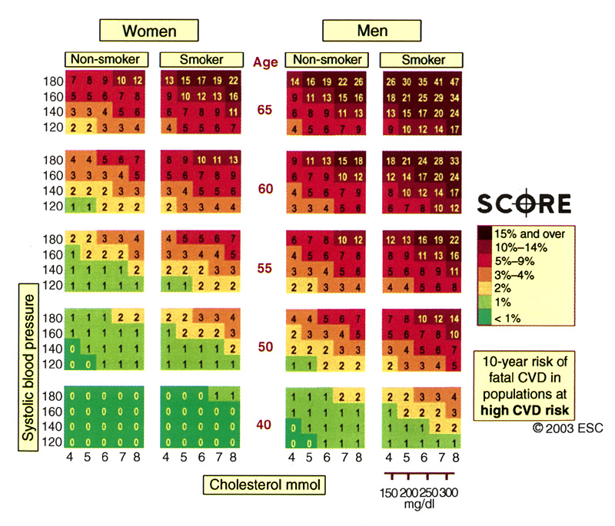

Slide 4


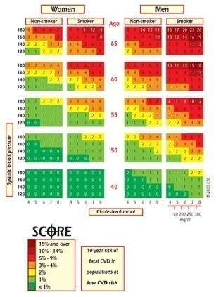
From SCORE to
Same risk factors
Same end-points
Same colours
The electronic interactive version of SCORE:
developed by the Research Centre for Prevention and Health, Glostrup University, Denmark

Slide 5
What are the OBJECTIVES of CVD prevention?
2. To achieve more rigorous risk factor control in high risk subjects, especially those with established CVD or diabetes through a healthy lifestyle and effective management of all risk factors:
    3.1 Blood pressure under 130/80 mmHg if feasible
    3.2 Total cholesterol <4.5 mmol/L (~175 mg/dL) with an option of <4 mmol/L (~155 mg/dL) if feasible
    3.3 LDL cholesterol <2.5 mmol/L (~100 mg/dL) with an option of <2mmol/L (~80 mg/dL) if feasible
    3.4 Fasting blood glucose <6 mmol/L (~110 mg/dL) and HbA1c <6.5% if feasible
3. To consider cardioprotective drug therapy in these high risk subjects especially those with established atherosclerotic CVD

Slide 6
Strategies for prevention of cardiovascular disease
Secondary prevention and rehabilitation strategy for patients with vascular disease

Slide 7

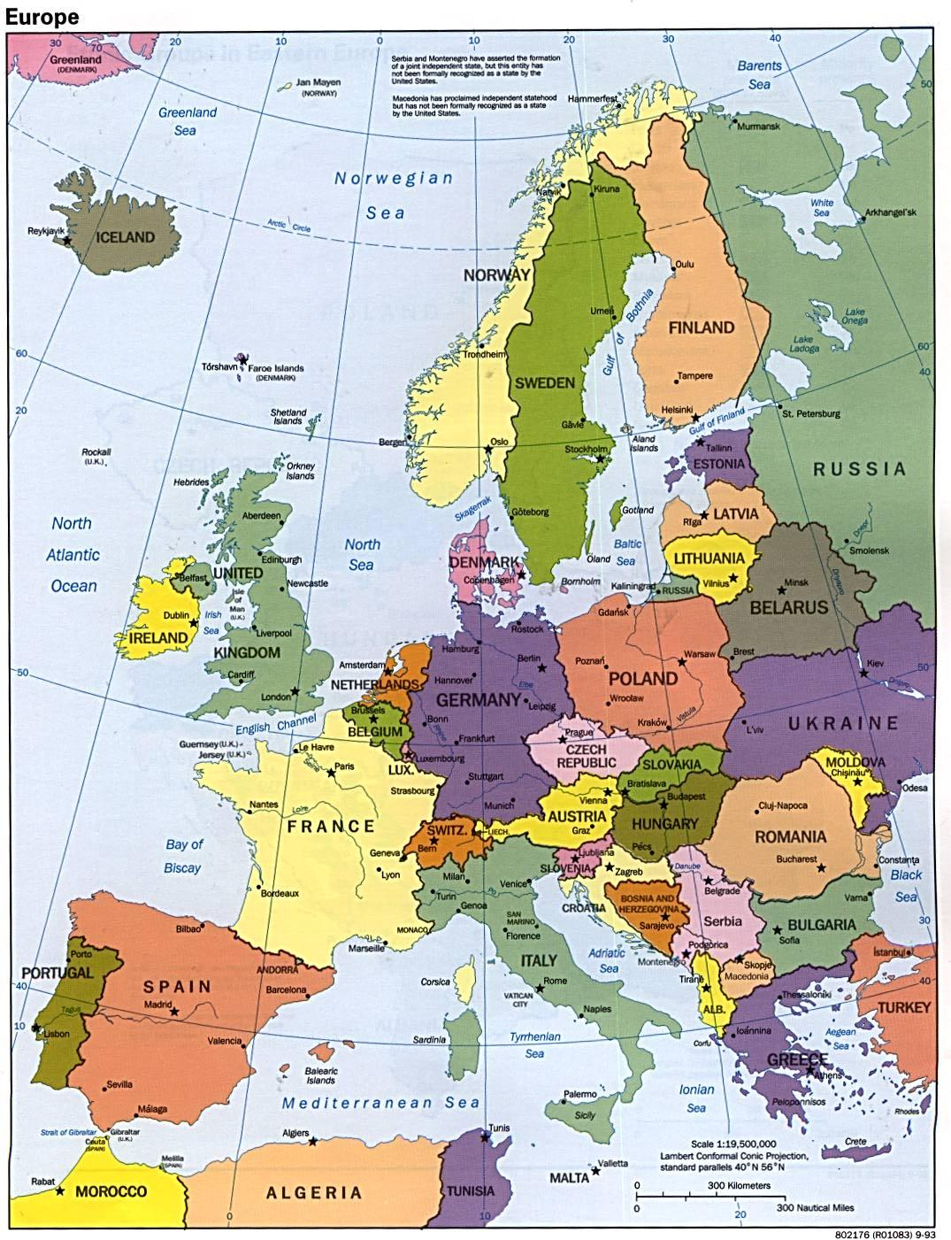








EUROASPIRE I, II and III
Finland
Netherlands
Germany
Slovenia
Czech Republic
France
Italy
Hungary
K Kotseva, et al Lancet 2009; 373; 929-940

Slide 8
Prevalence of smoking, obesity* and central obesity**
*Body mass index ≥ 30 kg/m²
**Waist circumference ≥ 88 cm for women and ≥ 102 cm for men

Slide 9
Prevalence of raised blood pressure*, elevated TC** and LDL-C***, and self-reported diabetes mellitus
*SBP/DBP ≥ 140/90 mmHg for non-diabetics or ≥ 130/80 mmHg diabetics
** TC ≥4.5 mmol/l; *** LDL-C ≥4.5 mmol/l

Slide 10
Cardiovascular Protective Drug Therapies

Slide 11
Cardiac rehabilitation for patients with CHD
Clinical outcomes | Treatment n/N | Control n/N | Statistical method | Effect size
Total mortality | 326/4295 | 381/4137 | OR (95%CI) | 0.80 (0.68,0.93)
Cardiac mortality | 211/2706 | 267/2665 | OR (95%CI) | 0.74 (0.61,0.90)
Taylor R et al, Am J Med 2004; 116:682-692

Slide 12




















EUROASPIRE III
Participating countries
Netherlands
Finland
Ireland
Russia
UK
Latvia
Germany
Lithuania
Czech Republic
Poland
Hungary
France
Belgium
Romania
Croatia
Bulgaria
Slovenia
Greece
Spain
Turkey
Italy
Cyprus
ESC - EUROASPIRE III - EHS

Slide 13
Attendance to a CPR programme
among all patients* by country
All patients: 36%
Men 37%
Women 34%
* Attending at least one session
CPR attendance rate if advised to follow = 81%

Slide 14
Proportion of patients attended a CRP by diagnotic category*
%
* Attending at least one session

Slide 15
Prevalence of CVD risk factors according to participation in a CRP
P=0.0008
p=0.14
p=0.004
%
p=0.83
p<0.0001
*Among patients smoking prior to the index vent
**BP ≥ 140/90 mmHg, (≥ 130/80 mmHg in patients with diabetes);*** TC ≥ 4.5 mmol/L

Slide 16
Cardiac rehabilitation for patients with CHD
Modifiable risk factors | Statistical method | Effect size
Total cholesterol | WMD (95%CI) | -0.37 (-0.63, -0.11)
LDL cholesterol | WMD (95%CI) | -0.20 (-0.53, 0.12)
HDL cholesterol | WMD (95%CI) | 0.05 (-0.03, 0.14)
Triglycerides | WMD (95%CI) | -0.23 (-0.39, -0.07)
SBP | WMD (95%CI) | -3.19 (-5.44, -0.95)
DBP | WMD (95%CI) | -1.18 (-2.68, 0.32)
Smoking prevalence | OR (95%CI) | 0.64 (0.50, 0.83)
Taylor R et al, Am J Med 2004; 116:682-692

Slide 17
Modern Preventive Cardiology programme
Lifestyle (smoking cessation, diet, physical activity) intervention
Psycho-social factors
Managing other risk factors (blood pressure, lipids and glucose) to target
Adherence with cardioprotective drug therapies for life.

Slide 18
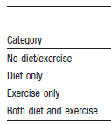
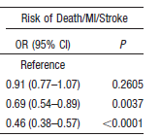
Impact of diet and exercise on early cardiovascular events after ACS
Chow C K, et al Circulation 2010; 121: 750-758

Slide 19
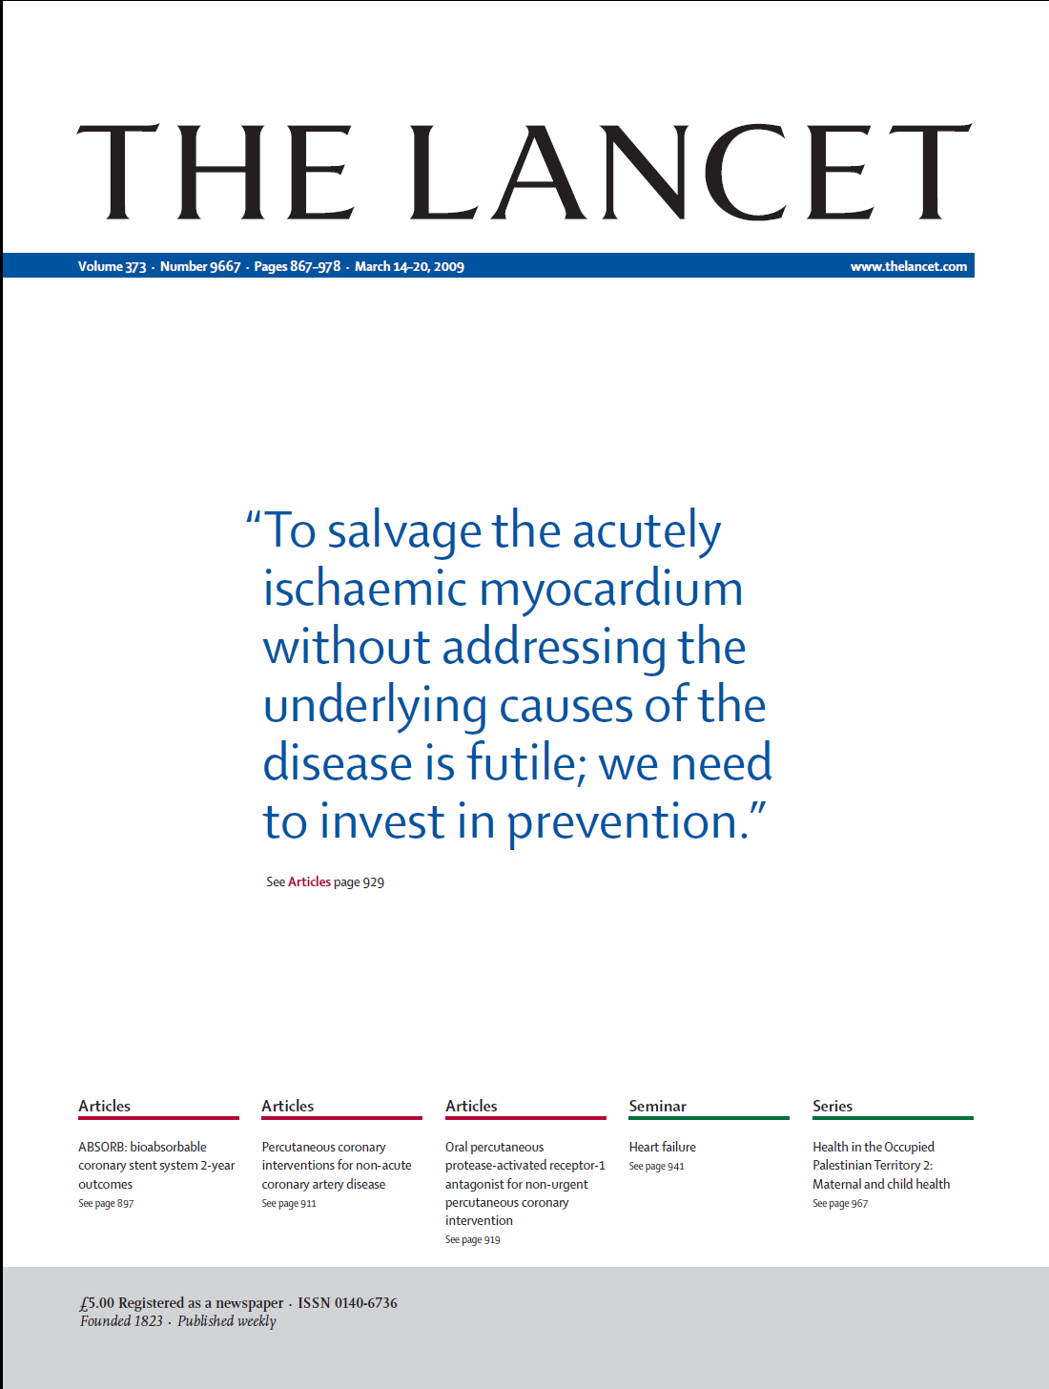

Slide 20
Strategies for prevention of cardiovascular disease
Primary prevention strategy for asymptomatic high risk individuals

Slide 21
Traditional medical paradigm
Hypertension
Hyperlipidaemia
Hyperglycaemia

Slide 22
New medical paradigm
Total cardiovascular risk

Slide 23
Impact of combinations of risk factors on 10 year risk of CVD death
SEX | AGE | CHOL | BP | SMOKE | RISK %
F | 60 | 8 | 120 | NO
F | 60 | 7 | 140 | YES
M | 60 | 6 | 160 | NO
M | 60 | 5 | 180 | YES
Notes:
23

Slide 24
Impact of combinations of risk factors on 10 year risk of CVD death
SEX | AGE | CHOL | BP | SMOKE | RISK %
F | 60 | 8 | 120 | NO | 2
F | 60 | 7 | 140 | YES | 5
M | 60 | 6 | 160 | NO | 8
M | 60 | 5 | 180 | YES | 21
Notes:
24

Slide 25

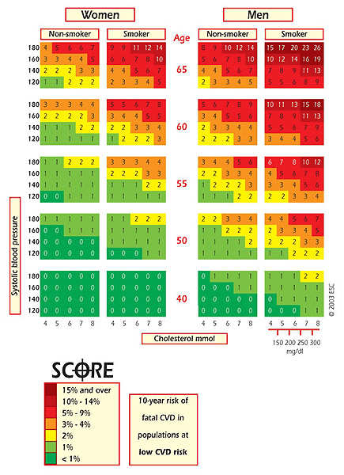
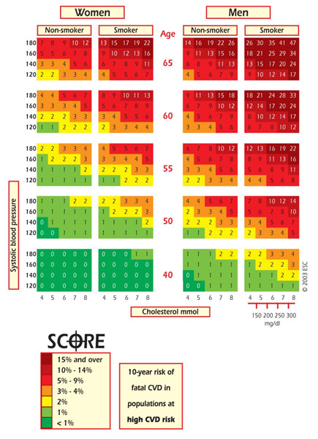
SCORE
Belgium, France, Greece, Italy, Luxembourg, Spain, Switzerland, Portugal
The rest of Europe
Low Risk Chart
High Risk Chart
Gender
Smoking status
Age
Systolic blood pressure
Total cholesterol
Based on Conroy et al, Eur Heart J, 2003, 24:987-1003 Copyright©: 2003 European Society of Cardiology. All rights reserved.
Based on Conroy et al, Eur Heart J, 2003, 24:987-1003 Copyright©: 2003 European Society of Cardiology. All rights reserved.
10 year risk of fatal CVD

Slide 26
New medical paradigm
Reduce total
cardiovascular risk

Slide 27
Modern Preventive Cardiology programme
Lifestyle (smoking cessation, diet, physical activity) intervention
Psycho-social factors
Managing other risk factors (blood pressure, lipids and glucose) to target
Adherence with cardioprotective drug therapies for life.

Slide 28
Multiple risk factor interventions for primary prevention of CHD
Outcome title | No of studies | No of participants | Statistical method | Effect size
Total mortality | 9 | 125167 | OR (95%CI) | 0.96 (0.92,1.01)
CHD mortality | 9 | 125167 | OR (95%CI) | 0.96 (0.89,1.04)
Ebrahim S et al, Cochrane Database of Systematic Reviews 2006

Slide 29
Multiple risk factor interventions for primary prevention of CHD
Outcome title | No of studies | No of participants | Statistical method | Effect size
SBP | 38 | 53872 | WMD (95%CI) | -3.62 (-3.93, -3.31)
DBP | 39 | 64859 | WMD (95%CI) | -2.76 (-2.93, -2.59)
Blood cholesterol | 35 | 66106 | WMD (95%CI) | -0.07 (-0.08, -0.06)
Smoking prevalence | 15 | 48948 | OR (95%CI) (random) | 0.81 (0.70, 0.94)
Ebrahim S et al, Cochrane Database of Systematic Reviews 2006

Slide 30



EUROASPIRE III PRIMARY CARE
Participating countries
Germany
Finland
UK
Latvia
Belgium
Poland
Slovenia
Romania
Spain
Croatia
Italy
Bulgaria

Slide 31
EUROASPIRE III PRIMARY CARE
* WC > 94 cm (men); > 84 cm (women)

Slide 32
EUROASPIRE III PRIMARY CARE
**SBP/DBP ≥ 140/90 mmHg for non-diabetics or ≥ 130/80 mmHg for diabetes
****Self-reported and/or glucose ≥ 7.0 mmol/l; **** in patients with self reported diabetes

Slide 33
EUROASPIRE III PRIMARY CARE
Cardioprotective drug therapies

Slide 34
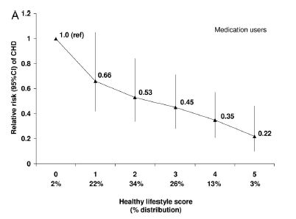
Healthy lifestyle score in medication users and risk of CHD
Chiuve S E Circulation 2006; 114: 160-167

Slide 35
Strategies for prevention of cardiovascular disease
Can we do better in preventive cardiology?

Slide 36
Cardiovascular Disease Prevention
European Society of Cardiology
www.escardio.org/prevention

Slide 37
Cardiovascular Disease Prevention
European Society of Cardiology
www.escardio.org/prevention
EUROACTION demonstration project in preventive cardiology

